Slide 1

Human Protein Atlas Bad Cell Recognition
Gabi Rivera, Itzel Cruz, and Edgar Rosales

Slide 2
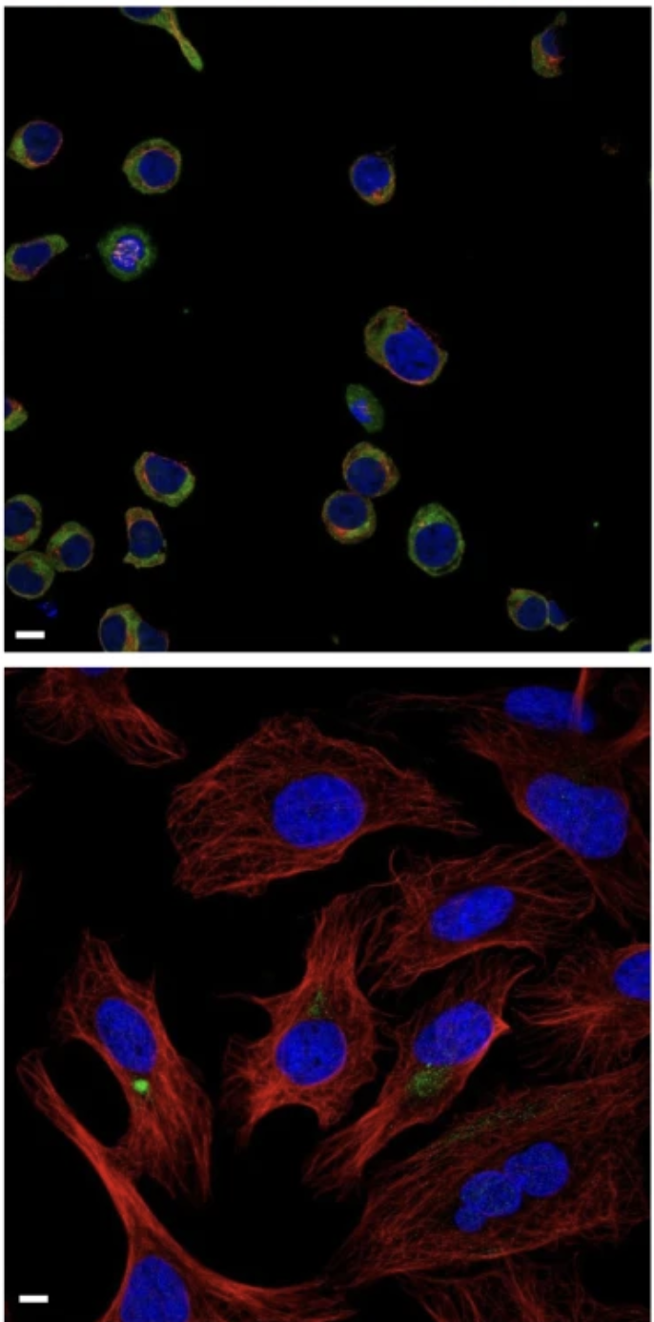
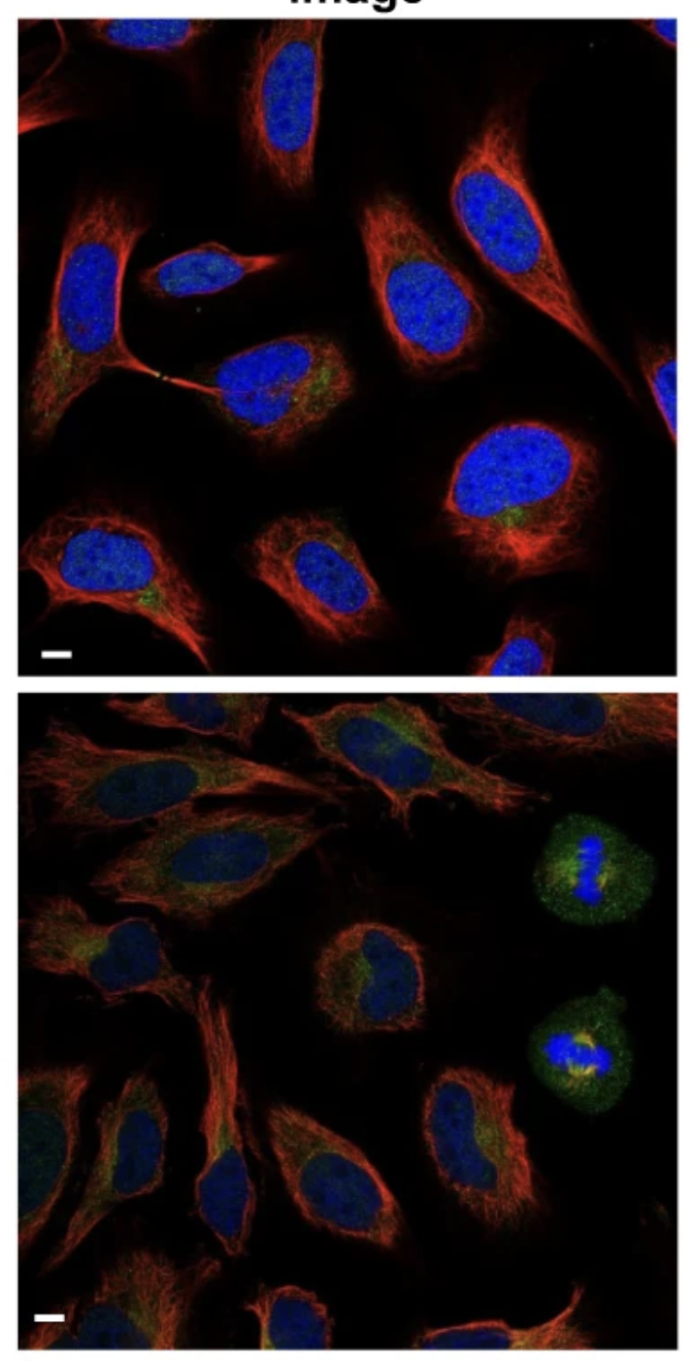
Introduction
Bad Cell Recognition
Human Protein Atlas Single Cell Recognition Challenge (Kaggle 2021)
HPA Bad Cell Detection Project (Kaggle 2022)
Goal: Develop a model that identifies badly recognized cells to improve segmentation errors of Single-cell Recognition platforms
High AUC-ROC score
General Data Info
26 features generated from the 4 channels of confocal microscopy image
Blue: nucleus
Yellow: endoplasmic reticulum (ER)
Red: microtubules
Green: target protein
isBad binary Outcome
0: correctly recognized
1: badly recognized
10533 observations
No missing values
(Husain et al,. 2023)

Slide 3
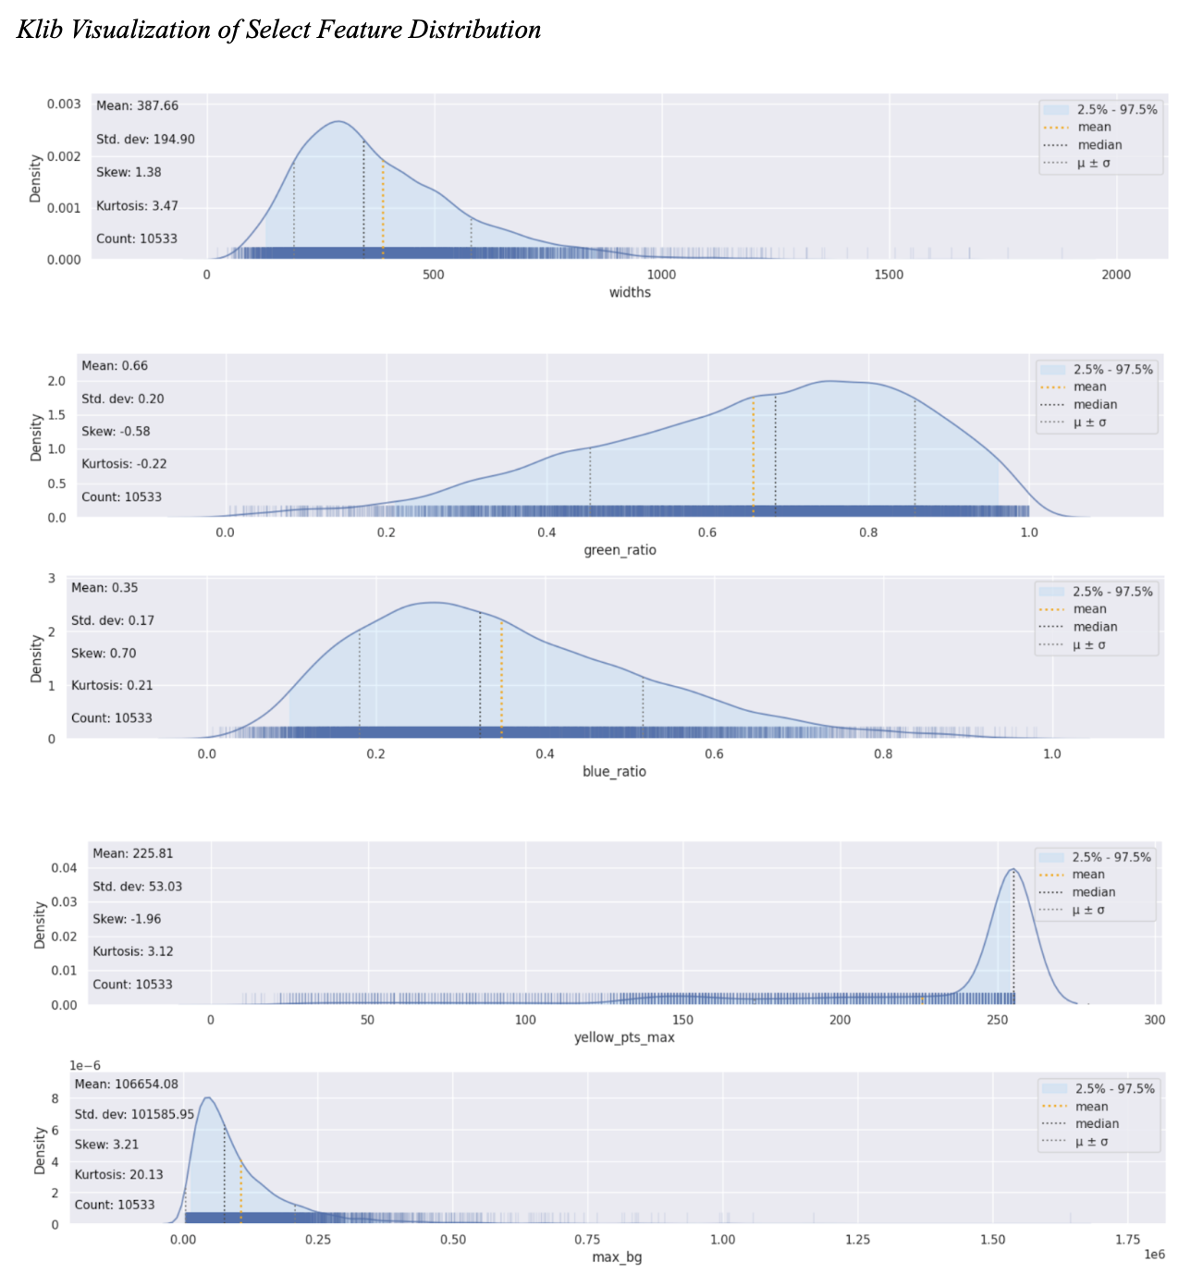
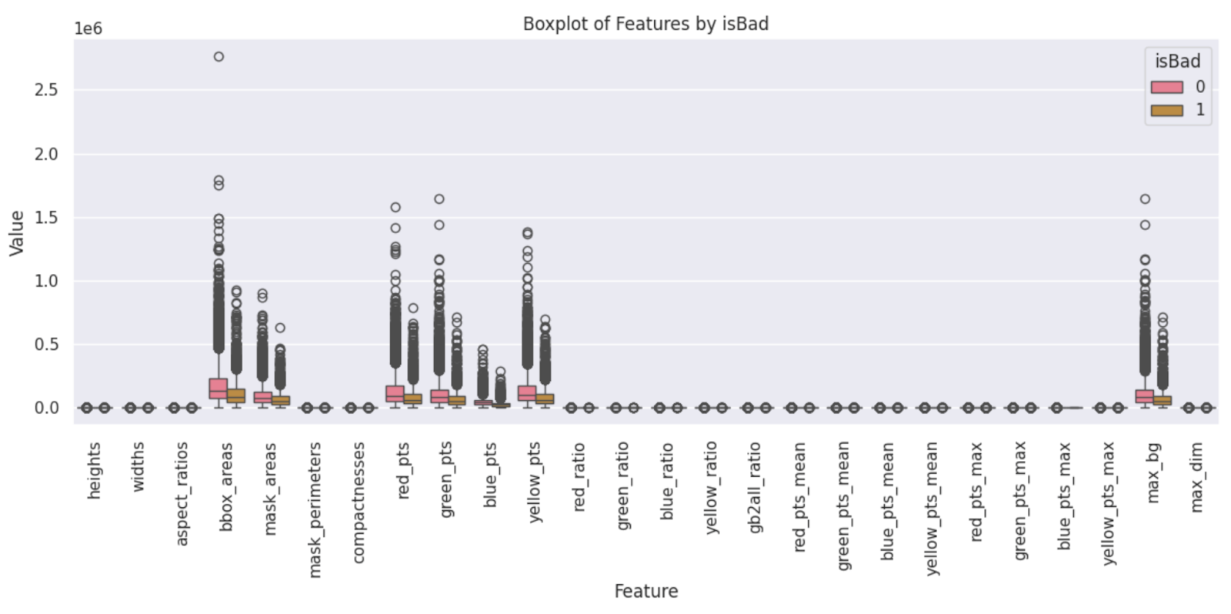
Exploratory Data Analysis

Slide 4

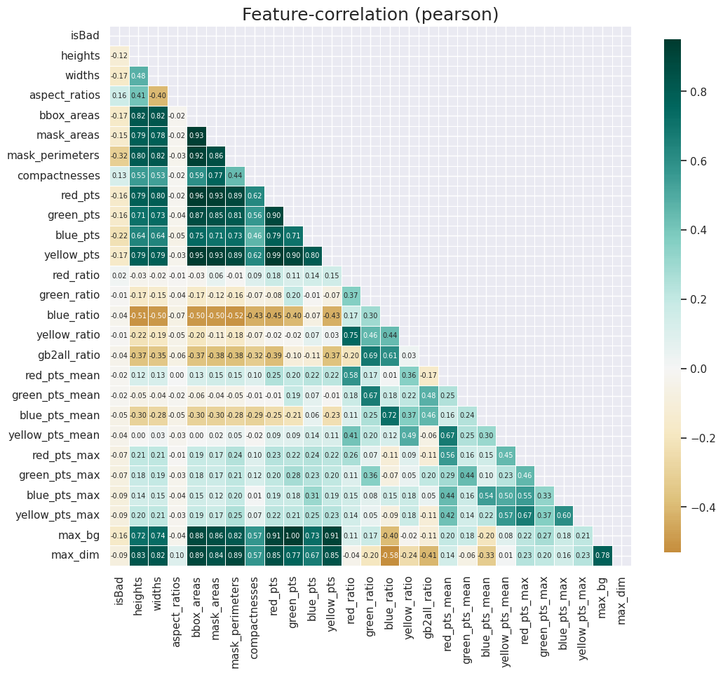
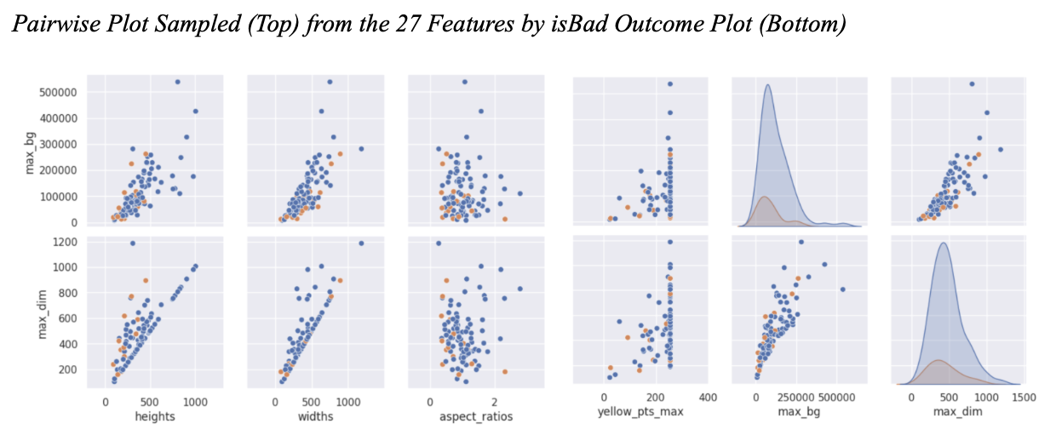
Exploratory Data Analysis

Slide 5
Data Wrangling and Splitting
Inspect the data
df.describe() provides summary statistics for the numerical columns, such as mean, standard deviation, min, and max values.
The df.info() output indicates that there are 10,533 entries and 28 columns in the dataset, with no missing values across all columns.
Feature Selection and Transformation
Relevant columns are converted to numeric types to ensure they are suitable for correlation analysis.
Features with a correlation higher than 0.8 are identified as highly correlated, meaning they might be redundant.
The dataset is reduced by dropping these highly correlated features, potentially improving model performance by removing multicollinearity.
Box-Cox Transformations
Box-Cox transformation is applied to the numerical columns to stabilize variance and make the data more normally distributed.
The PowerTransformer from sklearn is used as an alternative to perform Box-Cox transformation, which automatically handles non-positive values by shifting the data.
The transformed data using PowerTransformer is displayed to compare the results.
The dataset is split into features (X) and the target variable (y), with an 80-20 split into training and testing sets.

Slide 6
Model Strategies
Logistic Regression:
Binary Classification Model:
Traditional method for binary classification tasks.
Utilizes a linear decision boundary to separate classes.
Neural Networks:
Multi-Layer Perceptron:
Capable of capturing non-linear relationships in the data.
More flexible and powerful compared to traditional models like Logistic Regression.
K-Means
Centroid-Based Clustering
Clusters data points by minimizing the variance within clusters.
Effective for large datasets but sensitive to the initial placement of centroids.
Agglomerative Clustering
Hierarchical Clustering:
Builds clusters through a bottom-up approach by merging pairs of clusters.
Does not require specifying the number of clusters in advance.
XGBoost:
Boosted Decision Trees:
Ensemble method that builds trees sequentially to minimize errors.
Focuses on improving model accuracy through gradient boosting.
Support Vector Machine (SVM):
Hyperplane-Based Classification:
Works by finding the optimal hyperplane that separates classes.
Effective in high-dimensional spaces and non-linear classification.

Slide 7
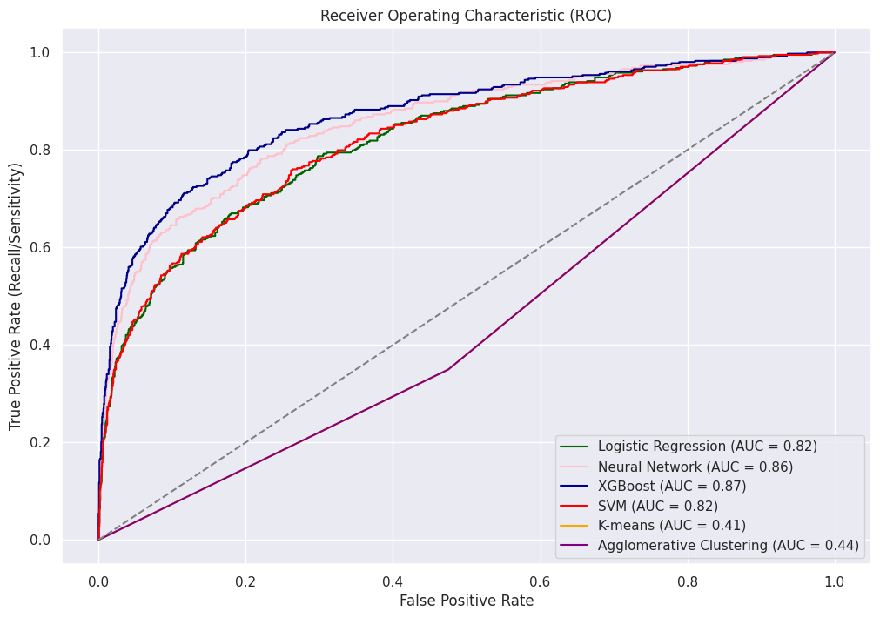
Performance Evaluation
Models on Test Dataset | Precision on Class 0 of isBad | Recall on Class 0 of isBad
Logistic Regression | 92% | 75%
Neural Network | 91% | 91%
XGBoost | 92% | 91%
Support Vector Machines | 87% | 97%
K-means Clustering | 77% | 52%
Agglomerative Clustering | 77% | 52%
Notes:
In our performance evaluation, we tested multiple models to determine the most effective for identifying 'bad' cells. XGBoost stood out with the highest AUC-ROC of 0.87, achieving 92% precision and 91% recall, making it the top performer. The Neural Network also showed strong results with an AUC-ROC of 0.86 and balanced precision and recall. SVM performed well, particularly in recall at 97%, but had lower precision at 87%. However, both K-means and Agglomerative Clustering underperformed, with significantly lower precision, recall, and AUC-ROC scores, making them less suitable for this task.

Slide 8
Conclusion
XGBoost:
Selected as the final model due to its superior balance of precision (92%), recall (91%), and AUC-ROC (87%). This makes XGBoost the most reliable model for effectively detecting single-cell segmentation errors and distinguishing between good and bad cells.
Neural Network:
A strong alternative that offers flexibility and robust performance. With a balanced precision (91%) and recall (91%), it remains a viable option in scenarios requiring adaptive modeling approaches.
Future Impact:
The findings of this study contribute to advancing the accuracy of cell segmentation in scientific workflows. The integration of AI and Deep Learning tools informed by this research has significant potential for applications in medical research, paving the way for more precise and effective approaches in future endeavors.
Notes:
In conclusion, after thorough evaluation, we selected XGBoost as our final model due to its superior balance of precision, recall, and AUC-ROC. This makes it highly effective for detecting segmentation errors in single-cell analysis. The Neural Network also emerged as a strong contender, offering both flexibility and robust performance.
Moving forward, the insights from this study will contribute to more accurate cell segmentation, with potential applications in medical research. By enhancing AI and Deep Learning tools in scientific workflows, we are paving the way for more precise and effective approaches in the future.

Slide 9
References
Caron, A., et al. (2022). Single-cell transcriptomics of breast cancer reveals heterogeneous subpopulations with distinct immune microenvironments. Nature Communications, 13, 1836. DOI: 10.1038/s41467-022-29676-7
Casper Winsnes, Emma Lundberg, Maggie, Phil Culliton, Trang Le, UAxelsson, Wei Ouyang. (2021). Human Protein Atlas - Single Cell Classification. Kaggle. https://kaggle.com/competitions/hpa-single-cell-image-classification
Husain, S.S., Ong, EJ., Minskiy, D. et al. Single-cell subcellular protein localisation using novel ensembles of diverse deep architectures. Commun Biol 6, 489 (2023). https://doi.org/10.1038/s42003-023-04840-z
Ong, E.-J., Minskiy, D., Bober-Irizar, M., Husain, S. S., & Bober, M. (2022). HPA Bad Cell Detection [Data set]. Kaggle. https://doi.org/10.34740/KAGGLE/DSV/3349136
Stubbington, M. J. T., et al. (2017). T cell fate and clonality inference from single-cell transcriptomes. Nature Communications, 8, 1080. DOI: 10.1038/s41467-017-01266-5

